Slide 1



UNIT 4
LESSON 14
Q for a question
Part 3

Slide 2
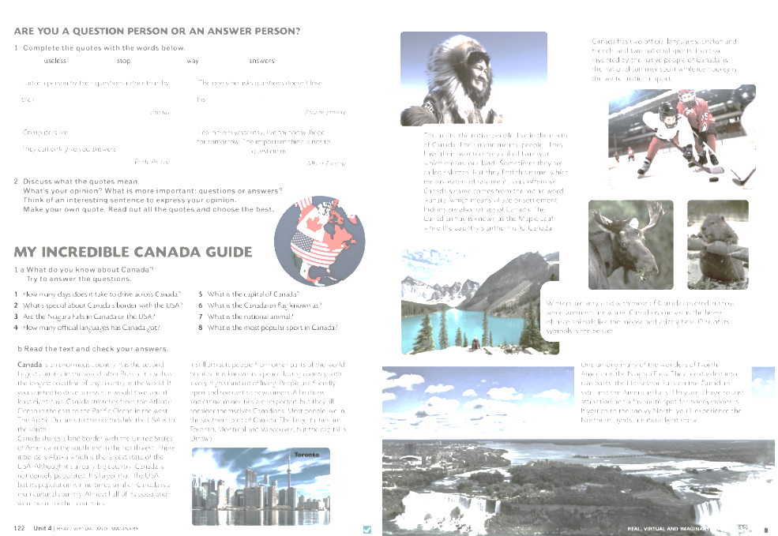
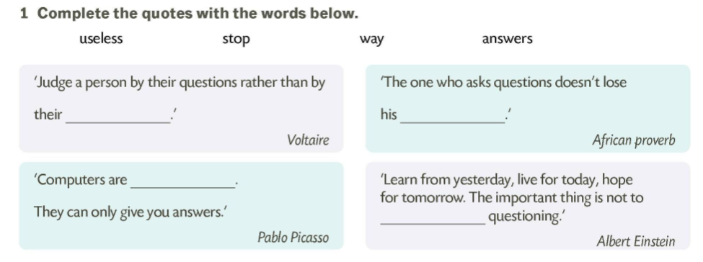

answers
way
useless
stop

Slide 3
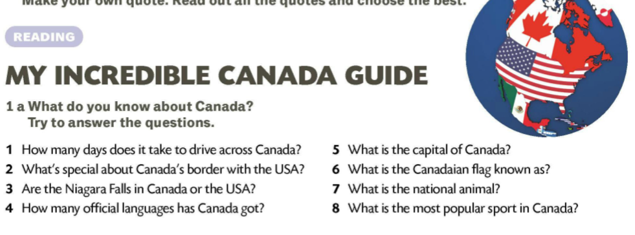
C A N A D A

Slide 4
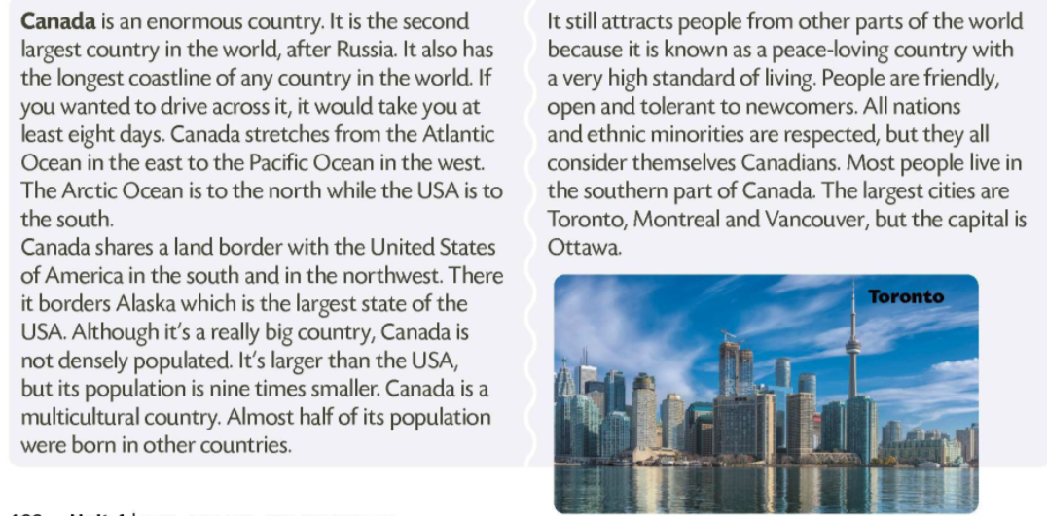

Slide 5
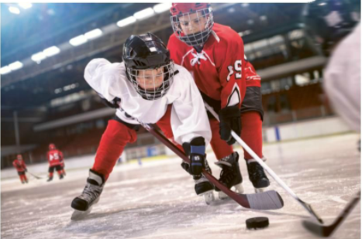
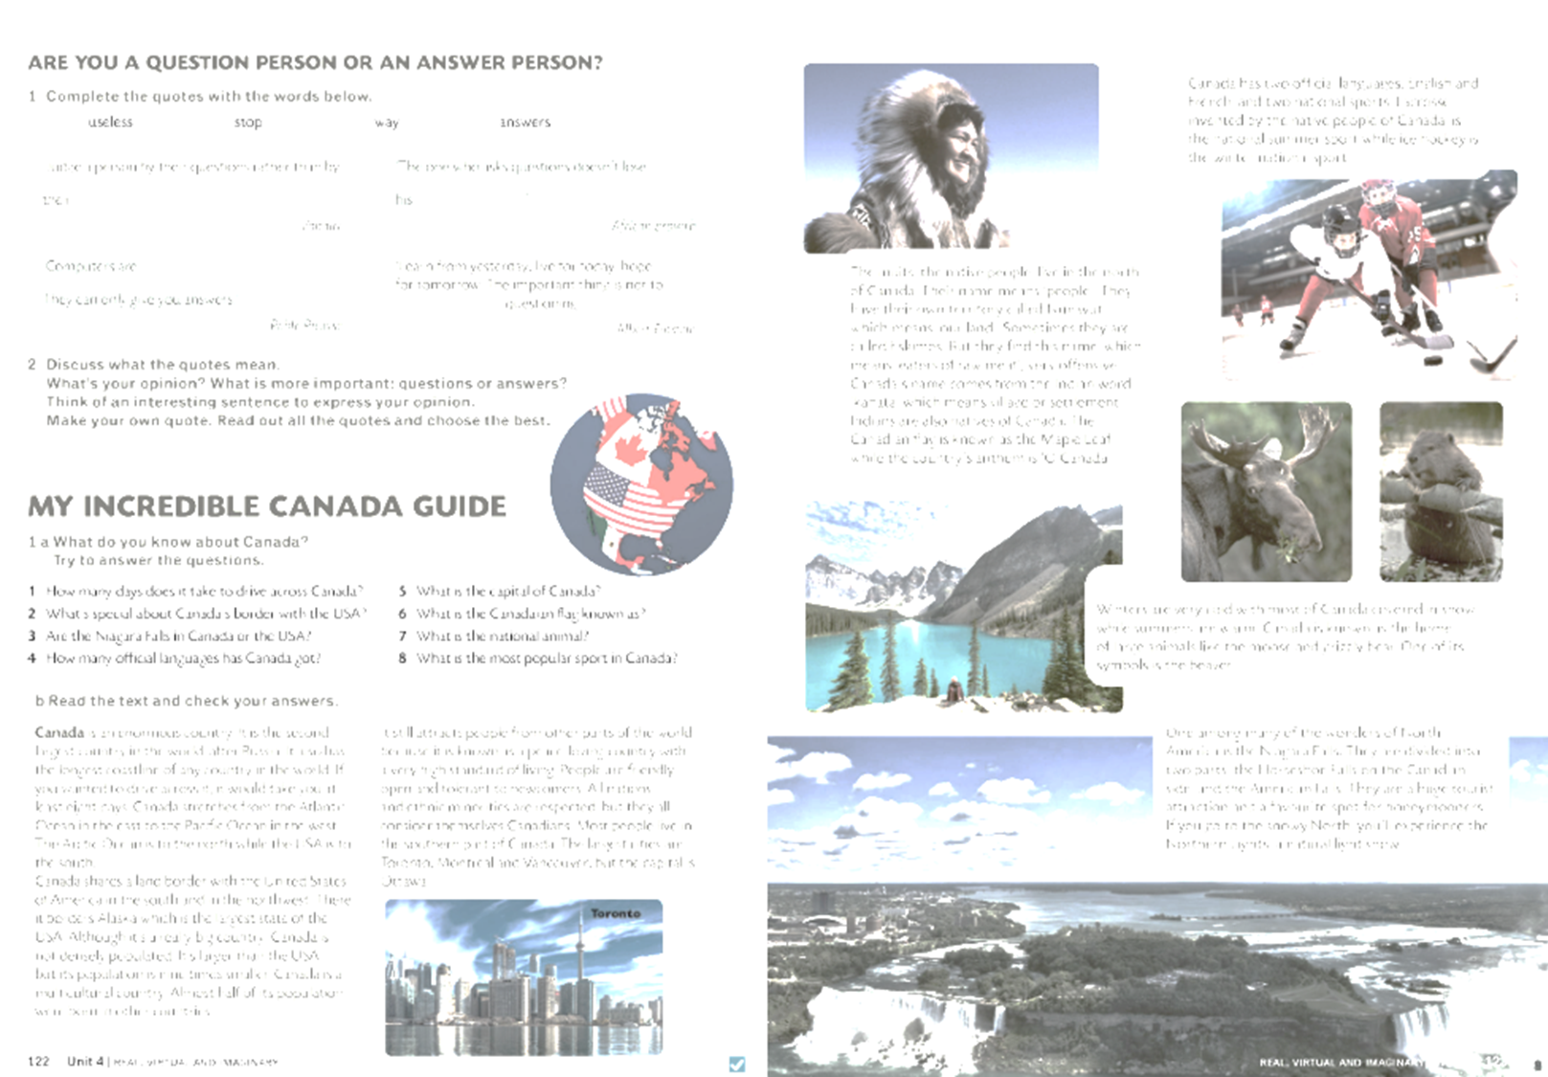
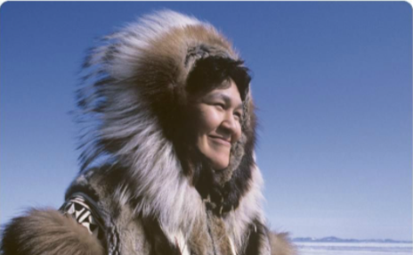
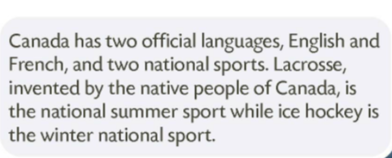
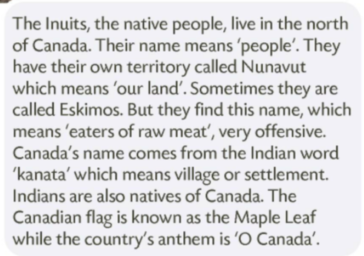
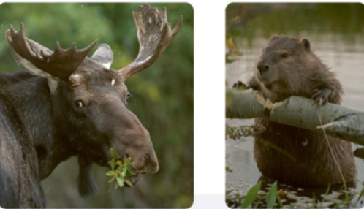

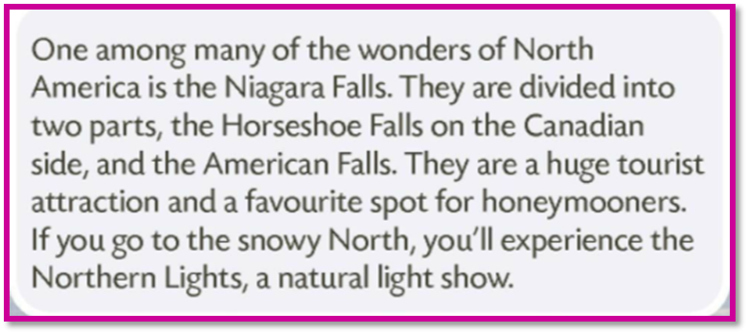


Slide 6
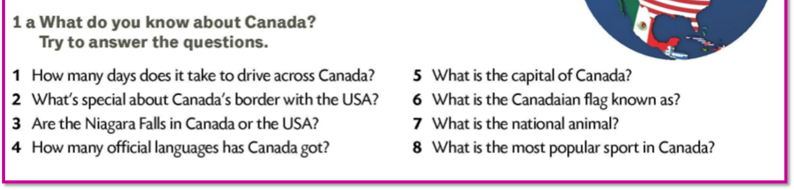
1 At least 8 days.
5 The capital of Canada is Ottawa.
2 It’s unprotected.
6 Canadian flag is known as the Maple Leaf.
3 Both in Canada and in the USA.
7 The national animal is the beaver.
4 Two: French and English.
8 The most popular sport is ice hockey in winter and lacrosse in summer.

Slide 7
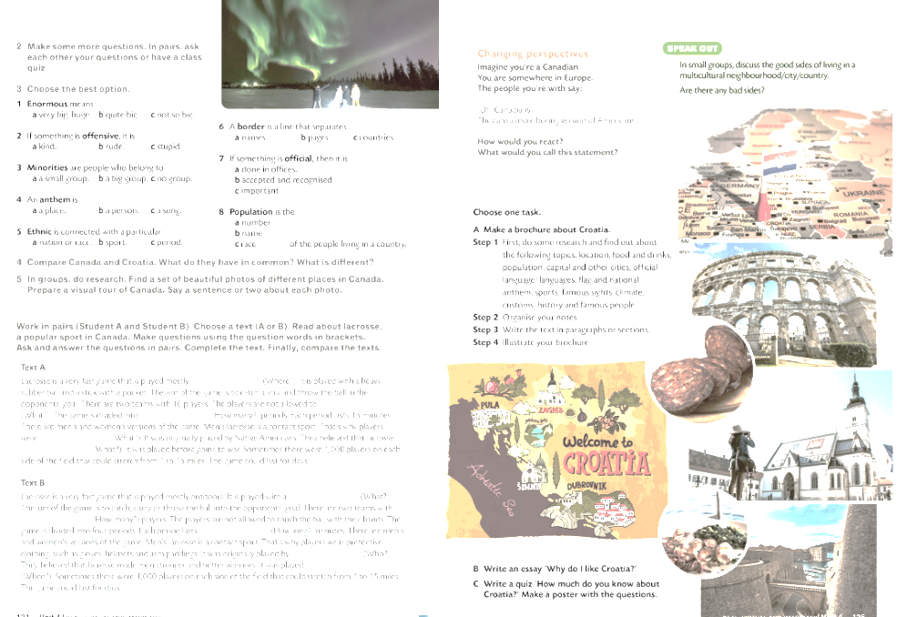
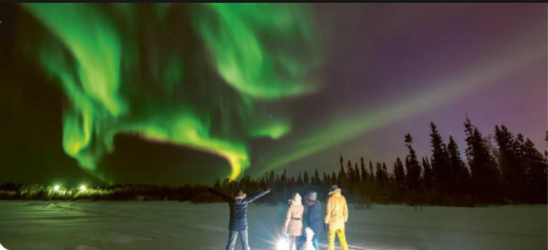

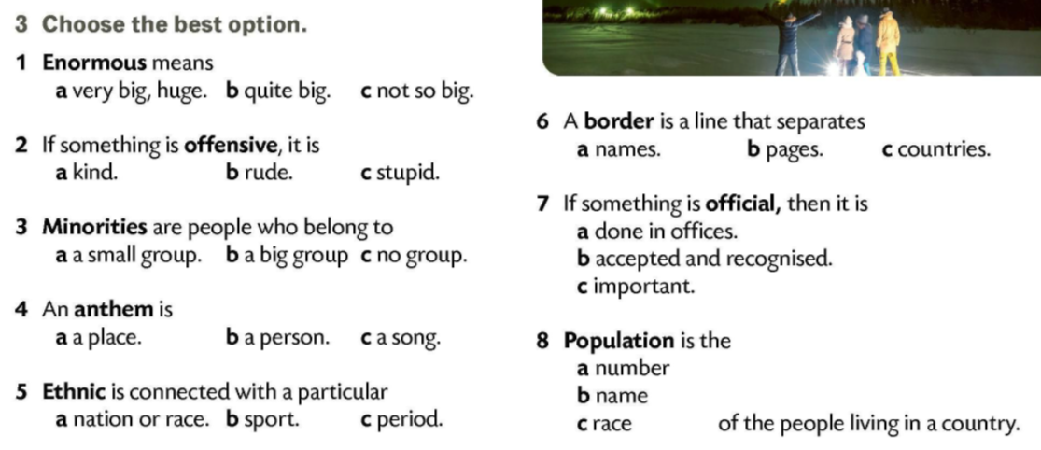

Slide 8
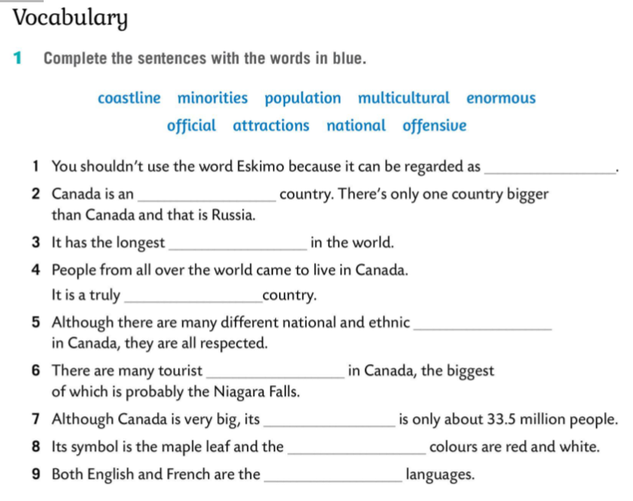
offensive
enormous
coastline
multicultural
minorities
attractions
population
national
official

